Slide 1

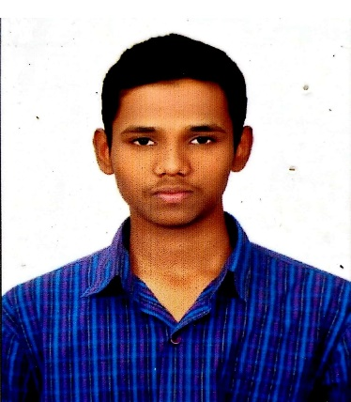



ZIA UL RAHMAN MOHAMMAD
Education :
Bachelor of Technology, Computer Science & Engineering : 2017 - 2021
skills :
Analyst/Software Engineer
Base Location: Mumbai
Email ID: ZIA-UL-RAHMAN.MOHAMMAD@CAPGEMINI.COM
Mobile No: +918341934186
Grade: A4
Java | Java, OOPS, Collections, Array, Loops, Exceptions.
Database | Postgre SQL
UI Tech | HTML 5 & CSS3, JavaScript, Typescript, Bootstrap
Tools | Git & GitHub, Eclipse, Swagger, Visual Studio Code, SQL shell.
Strengths
Full Stack Developer
Hands on experience on Core java, Postgre SQL.
Proficient in creating Single page Web Application in Angular with Authentication with routing.
Hands on experience in developing web pages using HTML5, CSS3, Object TypeScript.
Ready to learn new technologies and implement them for the Future Knowledge improvement.
Achievement
E-Auction System
Case study of E-Auction System along with Swagger, responsive UI with HTML5, CSS3, Bootstrap and ANGULAR used as User Interface.
https://github.com/Ziamohd/one-page-resume.git
Presentation Title | Author | Date © Capgemini 2017. All rights reserved | 1

